Slide 1
How to make a budget using bobcat gold
Texas State University CARE Center

Slide 2
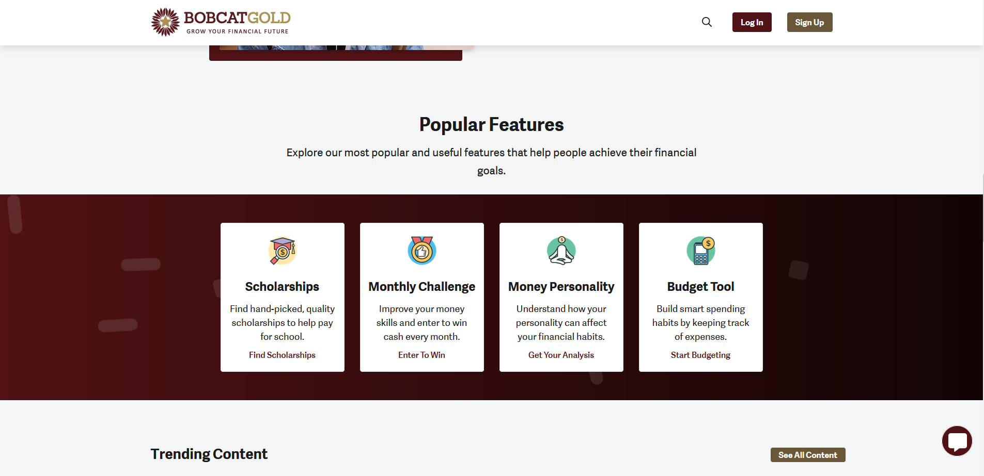
Step 1: Access the Budget Form
Open the Bobcat Gold Website
Scroll down to the Popular Features section
Click on the Budget Tool

Slide 3
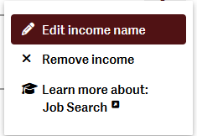
Step 2: Customize your Categories
To delete or change the name of a category click this button
If you want to add more categories, click here
If you have multiple jobs/sources of income, you can give each one its own category
Continue to customize your Expense categories as well.

Slide 4
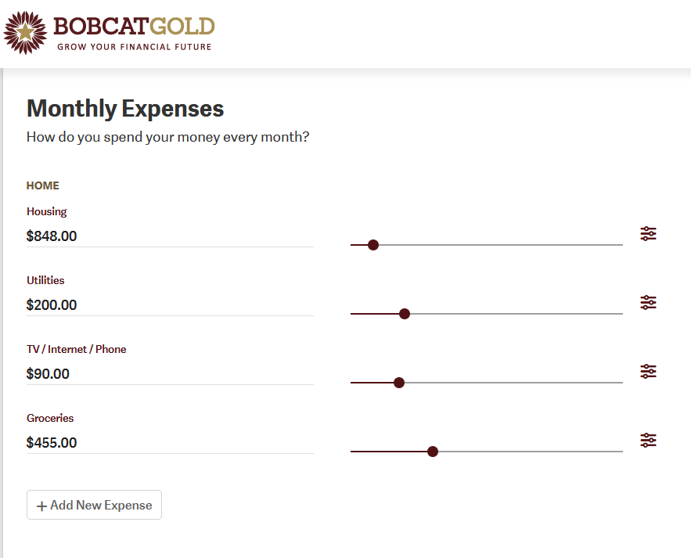
Step 3: Put in your income/expenses
Use the sliders to adjust the amounts for your income and expenses.
You can also type in your income/expense amounts by clicking on the category title
Remember that you can customize your expense categories to meet your needs.

Slide 5
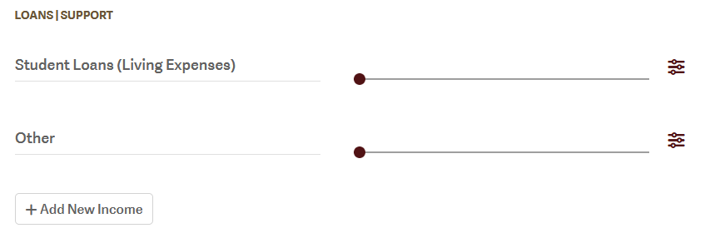
If you are submitting your budget for Emergency Funding:
If you are making this budget to add to your Emergency Funding application, please make these changes to your category names.
When putting in your financial aid refund take your total refund amount and divide it by 4. This will be your monthly refund amount.
(If Applicable)

Slide 6
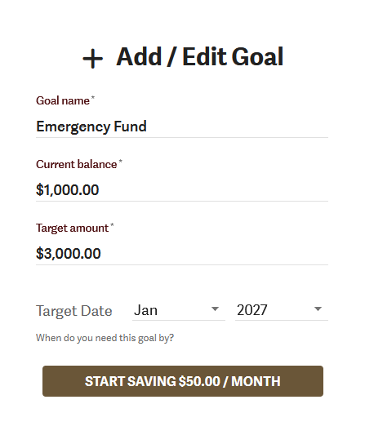
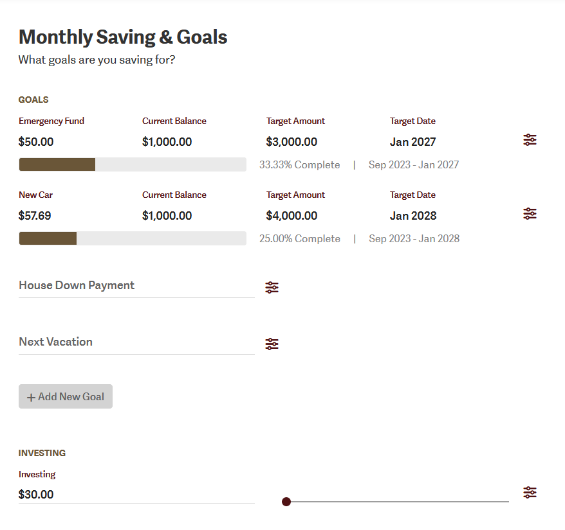
Are you saving up for something?
If you have a goal that you are working towards you can plan how much you want to have saved and your budget will calculate how much you will need to save each month to reach your target amount by your target date.

Slide 7
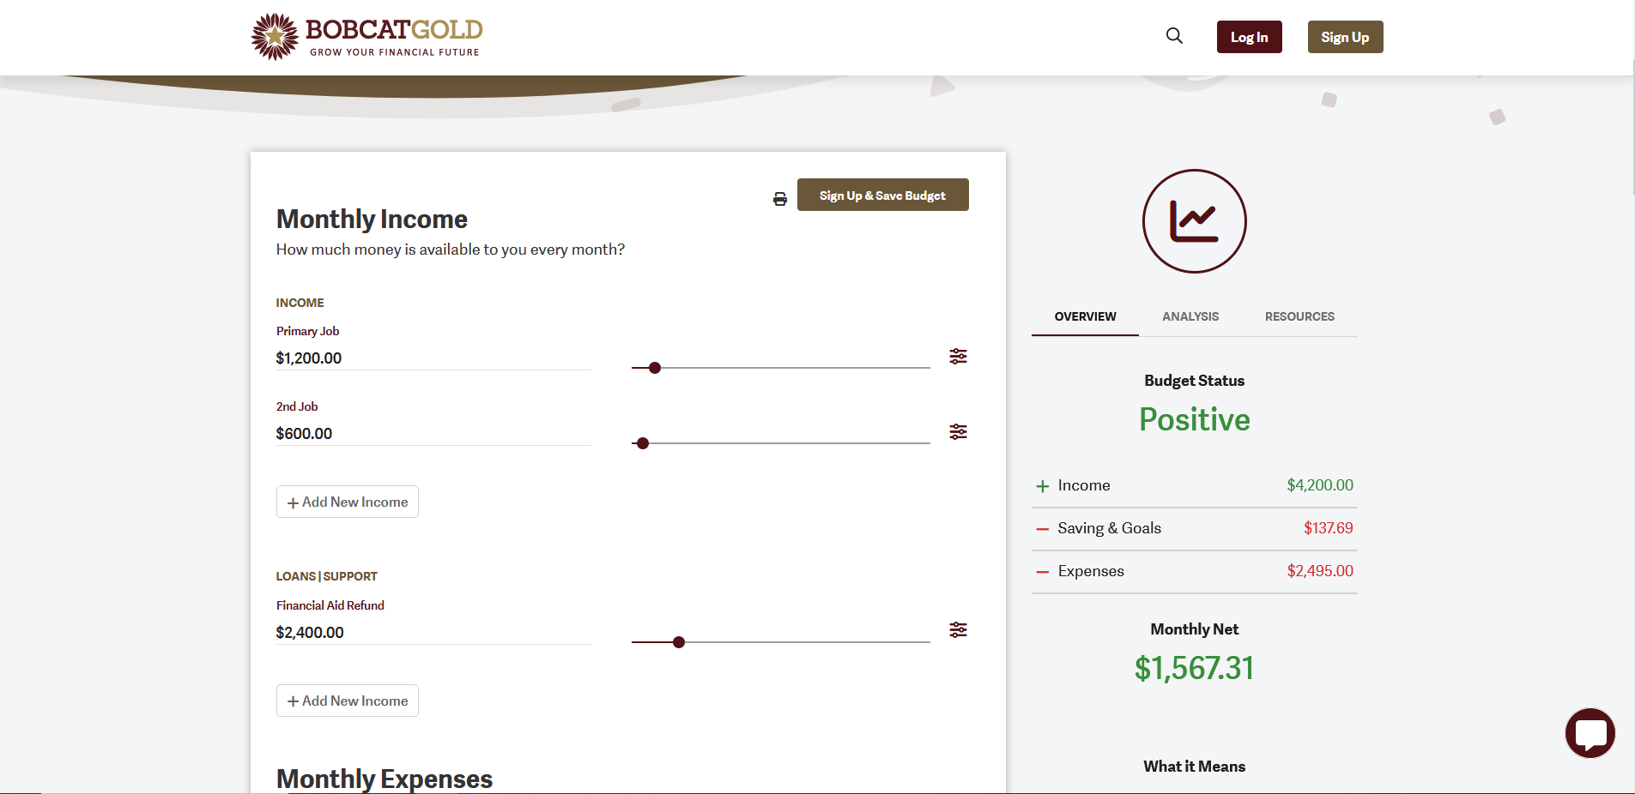
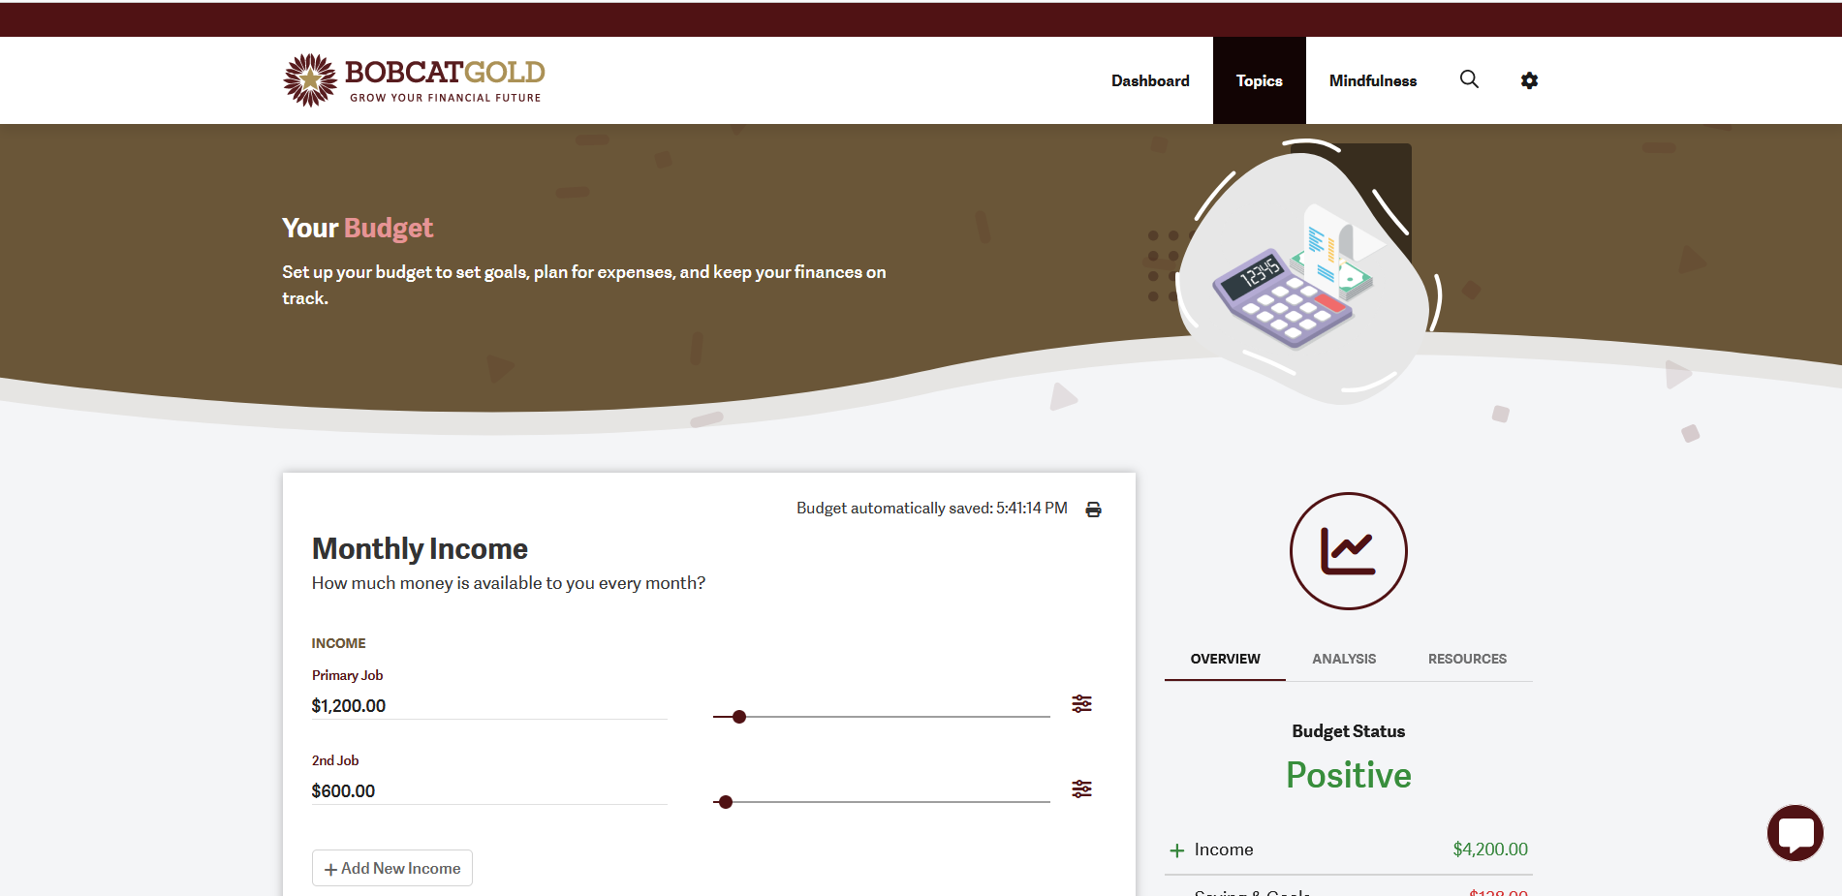
Step 4: Save your Budget
Now that you have completed filling out your budget you will need to save it
First click this button to sign in. You will need to log in using your TXST SSO
Once you are logged in click the print button to open your budget as a pdf

Slide 8
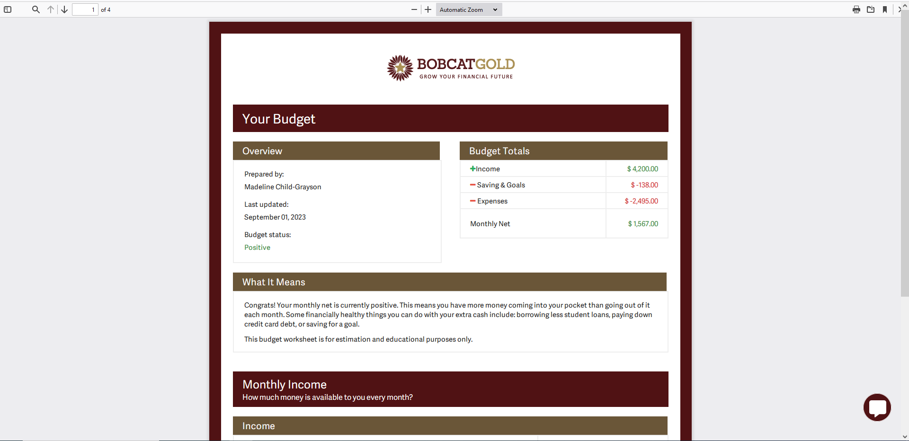
Step 5: Download your budget
Make sure to download your budget onto your computer and you are all done!
You can always go back and make changes to you budget as necessary in your Bobcat Gold account

